Slide 1
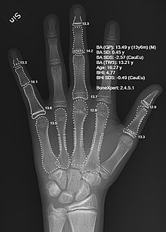
Bone Age Detection

Slide 2
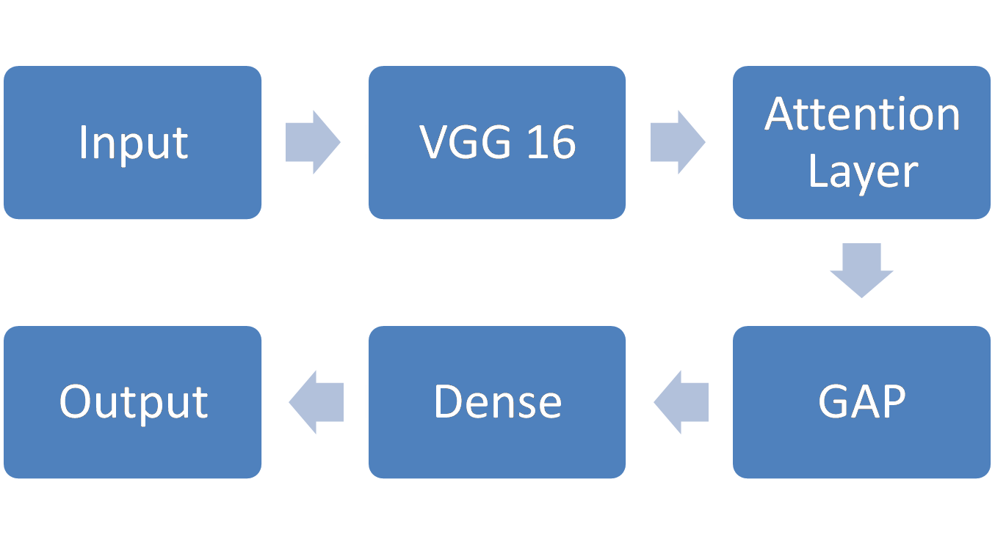
Skeletal Maturity Analysis Model

